Slide 1
MODERNIZATION AND EXPANSION OF SYSTEM TO SUPPORT THE MARKET – EDUCATION FOR EXTERNAL USERS

Slide 2
Content
System access
Basic data
CTR auctions
Scheduling
Balancing
Settlement

Slide 3
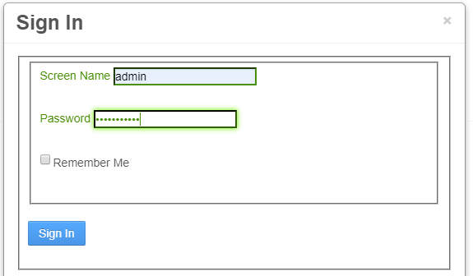
System access
https://webapps.eso.bg/konchar-mms

Slide 4
System access - Company selection
Company roles:
Capacity trader
Energy trader

Slide 5
System access - Notifications

Slide 6
Basic data - Companies

Slide 7
Basic data – Company detail

Slide 8
Basic data – Company detail - Persons

Slide 9
Basic data – Company detail - Informing

Slide 10
Basic data – Company detail - Settings

Slide 11
Basic data – Company detail - Auction roles

Slide 12
Basic data – Company detail – Banks and locations

Slide 13
Basic data – Company detail – Balance group and delegations

Slide 14
Basic data – Company detail - Accounting

Slide 15
Basic data – Balance groups

Slide 16
Basic data – Balance group detail

Slide 17
Basic data – Balance group detail

Slide 18
Basic data - Users

Slide 19
Basic data – User detail

Slide 20
Basic data – User detail – Company roles

Slide 21
Basic data – Power plants

Slide 22
Basic data – Generators

Slide 23
Basic data – Pumps

Slide 24
Basic data – Metering points

Slide 25
Basic data – Active users

Slide 26
CTR auctions
Auction type:
Yearly
Monthly
Daily
Intraday
Auction states:
Visible - auction is visible to traders
Open for bids – trader can enter the bids
Closed for bids – trader can no longer bid
Sorting done – bids are sorted
Results published – results are published and ECAN documents are sent to traders

Slide 27
CTR auctions – Auction list

Slide 28
CTR auctions – Auction detail

Slide 29
CTR auctions – Product

Slide 30
CTR auctions – Product

Slide 31
CTR auctions – Bids

Slide 32
CTR auctions – Yearly and mothly bid

Slide 33
CTR auctions – Daily bid

Slide 34
CTR auctions – Intraday bid

Slide 35
CTR auctions – Intraday bids

Slide 36
CTR auctions – Filling bid with xls file

Slide 37
CTR auctions – Bid restrictions
Offered price cannot be less than auction minimal price
Requested amount can not be larger than ATC
Sum of all bid cannot be larger than ATC
Number of bids cannot exceed the limit defined in the auction
All or nothing bids must be allowed in corresponding auction
There must be no unpaid invoices from the previous months

Slide 38
CTR auctions – Auction results

Slide 39
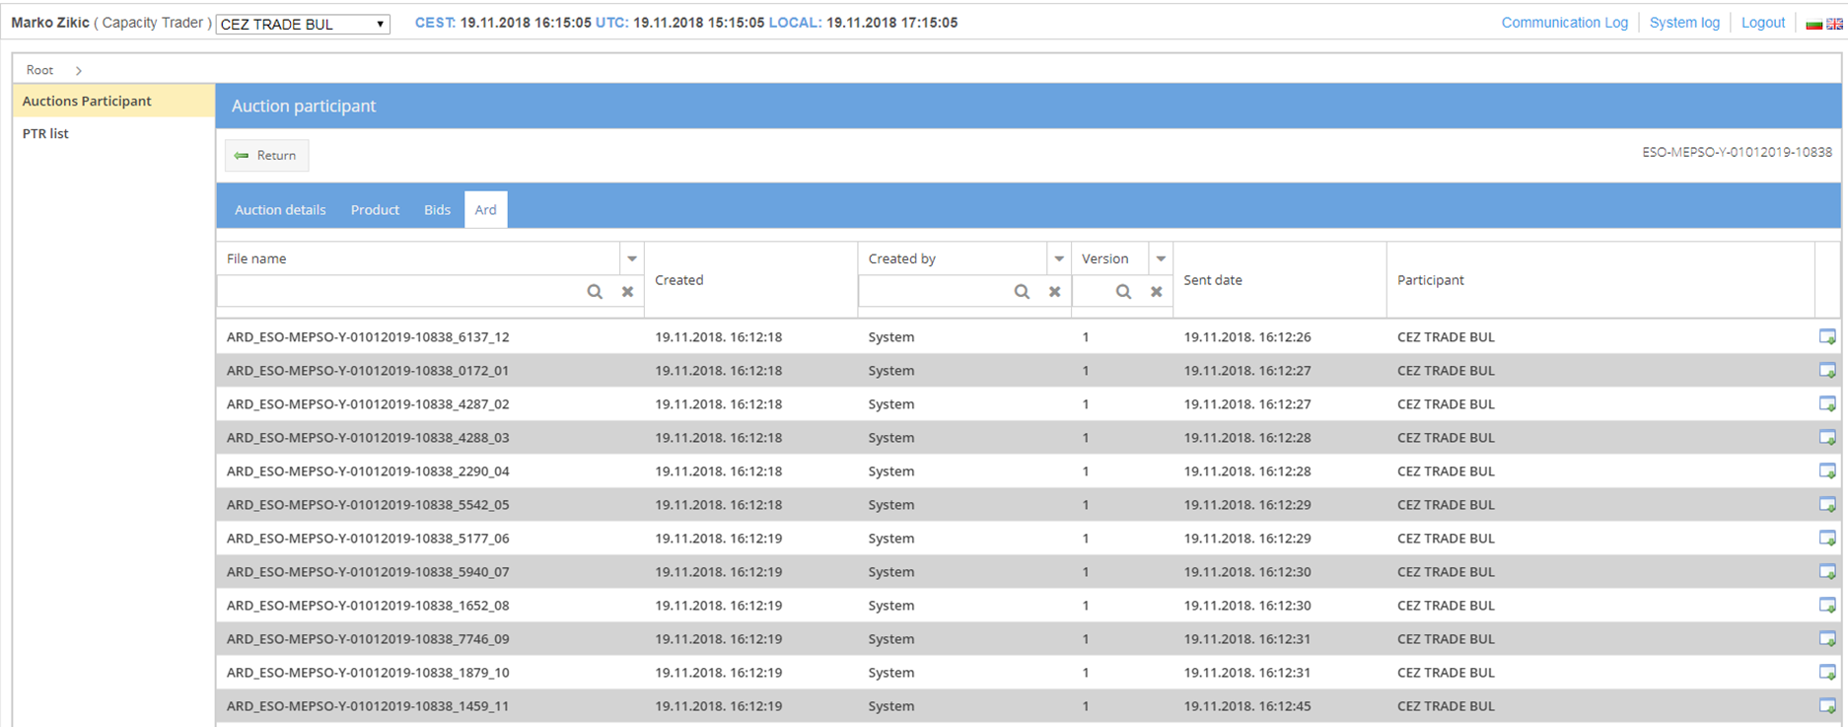
CTR auctions – ECAN documents - ARD
ARD – Allocation result document – generated automatically after publishing the results
Yearly auction – 12 ARDs (one for each month)

Slide 40
CTR auctions – ECAN documents – Right document
RD long – generated automatically based on system settings
RD daily – generated automatically after publishing auction results

Slide 41
CTR auctions – PTR list

Slide 42
CTR auctions – Secondary market
Resale
Transfer

Slide 43
CTR auctions – Secondary market - Resale

Slide 44
CTR auctions – Secondary market - Transfer

Slide 45
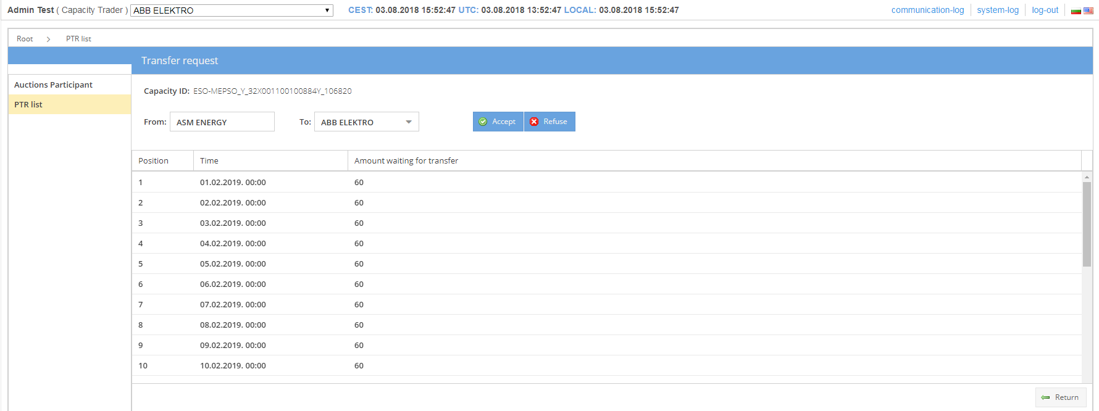
CTR auctions – Secondary market - Transfer
Accepting transfer request

Slide 46
CTR auctions – Secondary market – Canceling request
Option to cancel request
All request are automatically canceled if not accepted or refused after 4 hours

Slide 47
CTR auctions - Capacity reduction
Trader is notified if capacity reduction occurs
New right documents are sent

Slide 48
CTR auctions - Capacity reduction

Slide 49
CTR auctions - Capacity reduction

Slide 50
Scheduling – previewing messages
Choose the date, energy trader is automatically selected. In our case, the Energy trader is with EIC: 32X001100434S
Select message - energy trader that is representative of balance group, can see messages of energy traders that are in his balance tree.

Slide 51
Scheduling – message details

Slide 52
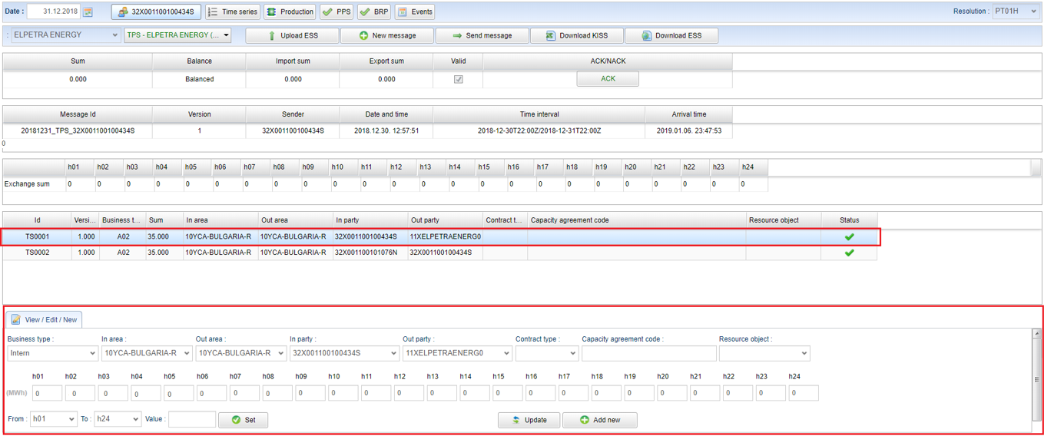
Scheduling – editing messages
The interface allows adding, removing and adjusting a schedule.

Slide 53
Scheduling – editing messages
The 15 minutes time interval

Slide 54
Scheduling – editing messages
Form menu right of the selected message, it is possible to upload ESS file, create a new message, send a message or download KISS or ESS file.
Mismatching schedules are automatically changed when the rules are applied.

Slide 55
Schedule validation errors (1)
Message header validation:
Sender is Balance Group Responsible -> A78 Sender Identification Role Invalid
ProcessType is Valid -> A59 Not Compliant To Local Market Rules
ScheduleClassificationType is Valid -> A59 Not Compliant To Local Market Rules
SenderRole is Valid -> A59 Not Compliant To Local Market Rules
Sender Contract valid -> A05 Sender Without Valid Contract
Deadline Exceeded -> A57 Deadline Limit Exceeded
Is Gate Open -> A57 Deadline Limit Exceeded
Version Exists -> A51 Message Identification Or Version Conflict
PPS Gate Closure -> A57 Deadline Limit Exceeded
MessageId conflict -> A51 Message Identification Or Version Conflict
Check Schedule Time Interval -> A59 Not Compliant To Local Market Rules
Check ESS Message Versioning -> A51 Message Identification Or Version Conflict
Check external exchange capacity -> A27 Cross Border Capacity Exceeded
Check next change hour -> A43 (Quantity Increased) / A44 (Quantity Decreased)

Slide 56
Schedule validation errors (2)
When MessageType = A01 - Internal Schedules:
ProcessType is A19 (Intraday Accumulated) not in Intraday -> A59 Not Compliant To Local Market Rules
ProcessType is A01 (Day Ahead) not in Day Ahead -> A59 Not Compliant To Local Market Rules
BusinessType different from A04 (Consumption) and A02 (Internal trade) -> A59 Not Compliant To Local Market Rules
InArea or OutArea different from ESO area -> A23 Area invalid
Intraday Msg Sender is not Power Exchange or is not between Parent and Child Balance Group -> A59 Not Compliant To Local Market Rules
When MessageType = A30 - Cross Border Schedules:
ProcessType is A19 (Intraday Accumulated) not in Intraday -> A59 Not Compliant To Local Market Rules
ProcessType is A01 (Day Ahead) not in Day Ahead -> A59 Not Compliant To Local Market Rules
BusinessType different from A03 (External trade no capacity) and A06 (External trade explicit capacity) -> A59 Not Compliant To Local Market Rules
InArea or OutArea is empty -> A23 Area invalid
InArea and OutArea are set to ESO area-> A23 Area invalid
When MessageType = A71 - Generator forecast:
ProcessType different from A17 (Schedule Day) -> A59 Not Compliant To Local Market Rules
BusinessType different from A01 (Production) -> A59 Not Compliant To Local Market Rules

Slide 57
Schedule validation errors (3)
Time Series Validations:
Check time series primary key -> A55 Time Series Identification Conflict
Check time series ID -> A55 Time Series Identification Conflict
Check time interval definition -> A04 Time Interval Incorrect
Check time interval positions -> A49 Position Inconsistency
Invalid resolution -> A41 Resolution Inconsistency
Depending on business type quantity must not be signed value -> A46 Quantities Must Not Be Signed Values
Check is valid BusinessType -> A59 Not Compliant To Local Market Rules
Check is valid ObjectAggregation -> A59 Not Compliant To Local Market Rules
Check is valid MeasurementUnit -> A59 Not Compliant To Local Market Rules
Check is valid CapacityAgreementID -> A20 Time Series Fully Rejected
Check InArea/OutArea -> A23 Area Invalid
Check InParty/OutParty -> A22 Party Invalid
Matching scope change in SOSO matching -> A59 Not Compliant To Local Market Rules
Missing time series -> A52 Time Series Missing From New Version Of Message
Modification of the faultless time series -> A63 Time Series Modified
When Metering point is defined - Object Aggregation must be A02 -> A20 Time Series Fully Rejected
When Metering point is defined - Business Type must be A01 or A04 -> A20 Time Series Fully Rejected
PPS:
Validate resource object -> A64 ResourceObjectInvalid
Validate resource object technical limits -> A65 Reserve Object Technical Limits Exceeded
When Metering point is defined - Message Type must not be A01 -> A59 Not Compliant To Local Market Rules

Slide 58
Scheduling – Time series
All imported intern and extern scheduling files
Filtering columns

Slide 59
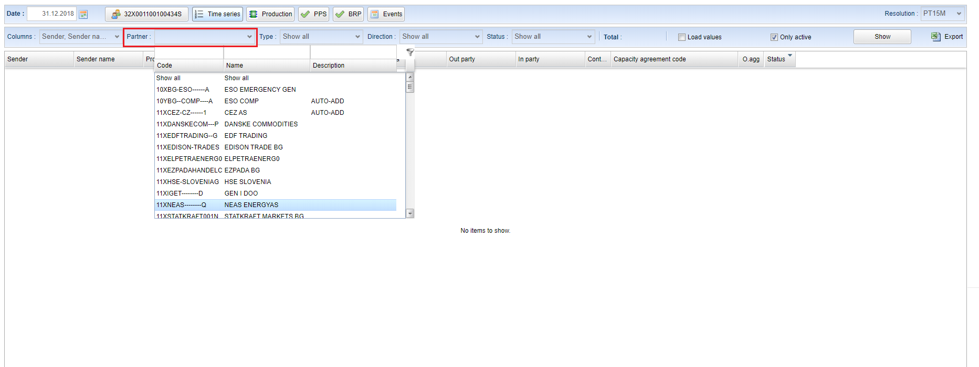
Scheduling – Time series
Filtering by the partner
Possible to filter messages by the direction of trade or Time series status by clicking the drop-down in the Direction or Status field.

Slide 60
Scheduling – Time series
Previewing time series
Loading values

Slide 61
Scheduling – Events
The process of receiving, sending, opening, matching, and closing is tracked and displayed.

Slide 62
Scheduling – Production
Power plants and generators are shown

Slide 63
Scheduling – PPS and BRP
PPS - displays balance between production and trade for market participants
BRP - validates the balance of all the time series from a single market participant

Slide 64
Balancing - Products
Two tertiary energy products are always presented in the system (one for purchase and one for delivery)

Slide 65
Balancing - Auctions
Two auctions are automatically created by each day (one for purchase and one for delivery)
Auction period is always daily
Auctions states - visible, active, open for bids, closed for bids, sorting done, results published

Slide 66
Balancing – Auction detail

Slide 67
Balancing – Bids
Three ways to enter the bids:
Bid form
Manual uploading the bid file
Sending the bid file via e-mail

Slide 68
Balancing – Bids – Bid form

Slide 69
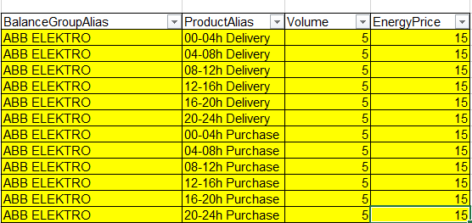
Balancing – Bids – Manual uploading the bid file

Slide 70
Balancing – Bids – Sending the bid file via e-mail
Bid file is send to the corresponding address
System checks if sender address is valid
The system sends a reply with information whether the offer is accepted or rejected

Slide 71
Balancing – Bids – Restrictions
Two Auctions (purchase and delivery) must be created in the system and opened for bids
Person must be authoriazed to bid
Bidder must be in the list of valid balancing groups
Energy price cannot be less than auction min energy price
Energy price cannot be bigger than auction max energy price
Offered amount cannot be less than auction min offered amount
Offered amount cannot be bigger than auction max offered amount!

Slide 72
Balancing – Bids – Auction results

Slide 73
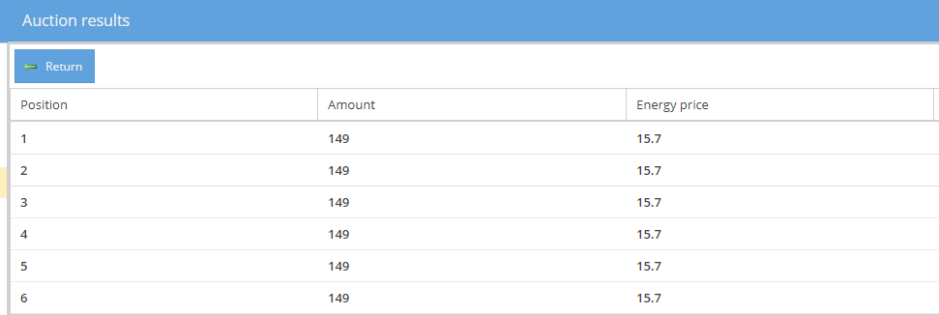
Balancing – Bids – Auction results

Slide 74
Settlement
Calculation data points can be viewed using the Settlement button.
Filer by:
Time period
Resolution
Data point name
Data point description
Balance group
Data point type:
- Component
- Account
- Metering

Slide 75
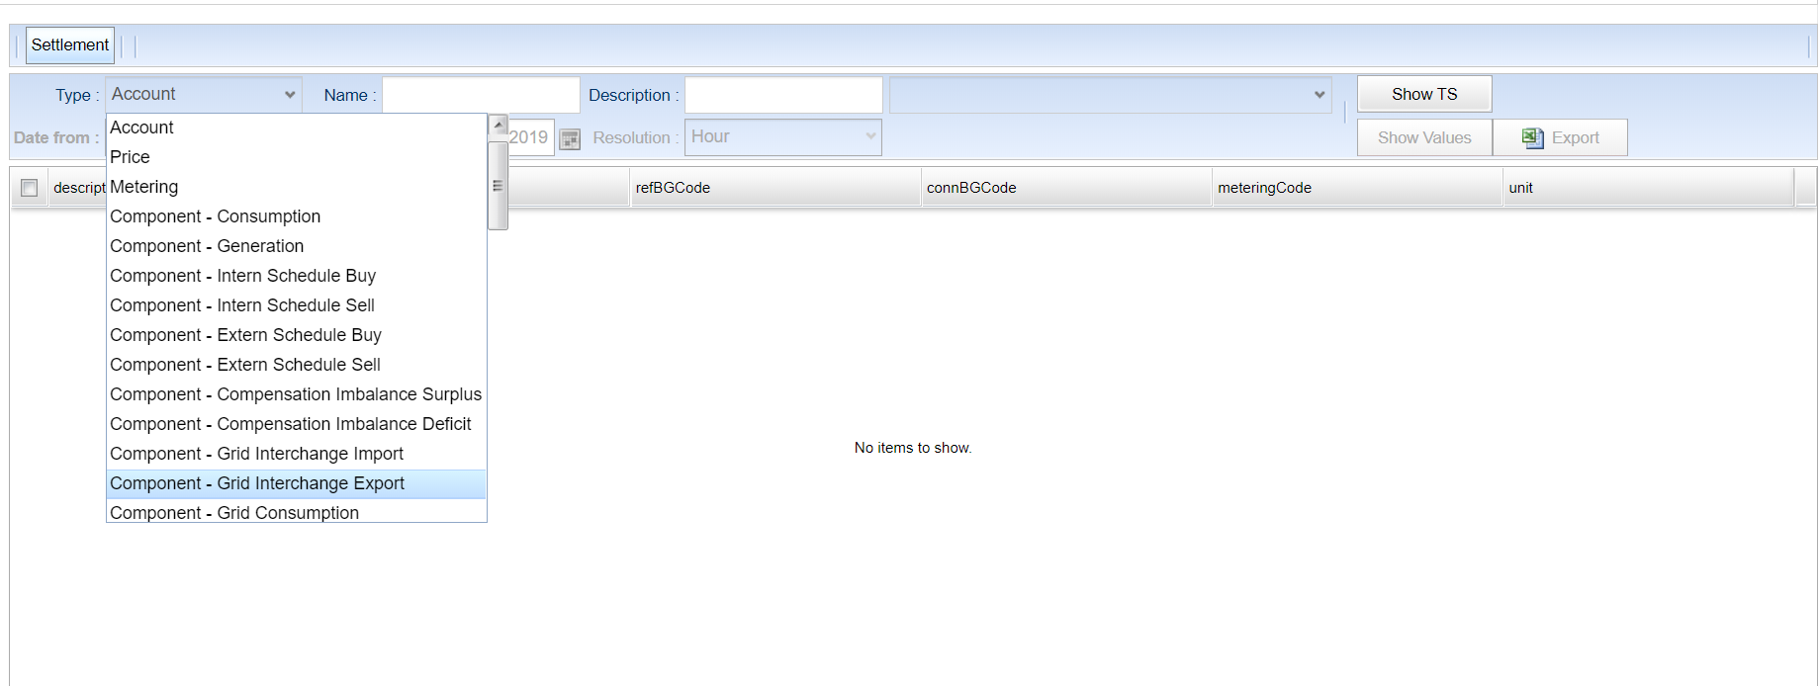
Settlement
It is necessary to select the type of data point from the drop-down menu, filter by name, display name or EIC code and click Show TS.
All of the data points that match the filter criteria are shown.

Slide 76
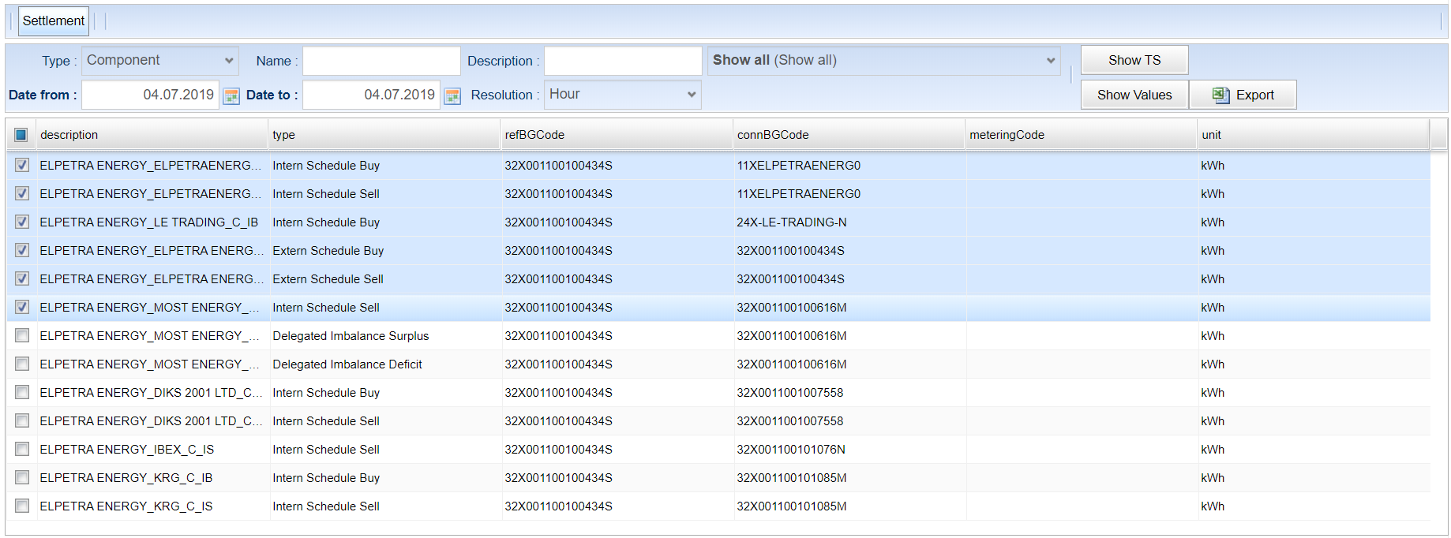
Settlement
A user must select rows or select all of the rows, select the time period and resolution and click Show values or Export.

Slide 77
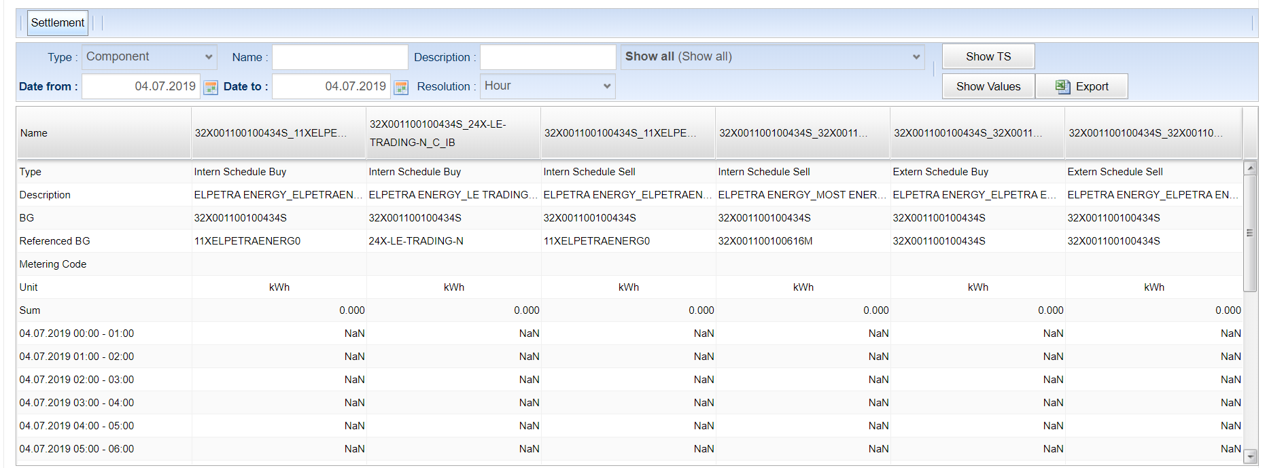
Settlement
Values

Slide 78
Settlement datapoints
C_C Consumption
C_G Generation
C_IB Intern Schedule Buy
C_IS Intern Schedule Sell
C_EB Extern Schedule Buy
C_ES Extern Schedule Sell
C_DIS Delegated Imbalance Surplus
C_DID Delegated Imbalance Deficit
C_L_I Losses Import
C_L_E Losses Export
A_C Consumption
A_G Generation
A_SB Schedule Buy
A_SS Schedule Sell
A_IS Imbalance Surplus
A_ID Imbalance Deficit
A_DIS Delegated Imbalance Surplus
A_DID Delegated Imbalance Deficit
A_L Losses
A_PR_U Primary Reserve Up
A_PR_D Primary Reserve Down
A_SR_U Secondary Reserve Up
A_SR_D Secondary Reserve Down
A_CR_U Cold Reserve Up
A_TR_U Tertiary Reserve Up
A_TR_D Tertiary Reserve Down
A_SR_UR Secondary Reserve Up Receivables
A_SR_DP Secondary Reserve Down Payables
A_CR_UR Cold Reserve Up Receivables
A_TR_UR Tertiary Reserve Up Receivables
A_TR_DP Tertiary Reserve Down Payables
A_P Payables
A_R Receivables
A_ISB Intern Schedule Buy
A_ISS Intern Schedule Sell
A_ESB Extern Schedule Buy
A_ESS Extern Schedule Sell
P_SR_U Price Secondary Reserve Up
P_SR_D Price Secondary Reserve Down
P_CR_U Price Cold Reserve Up
P_TR_U Price Tertiary Reserve Up
P_TR_D Price Tertiary Reserve Down

